Slide 1
Java Script KIRISH
Ustoz: Suyunov Husan

Slide 2
JavaScript haqida quyidagi asosiy nuqtalarni aytishim mumkin:
JavaScript web sahifalarini dinamik va interaktiv qilib berish uchun ishlatiladigan keng tarqalgan skript tilidir.
HTML belgilovchasi <script> ichida yoki tashqi .js fayllarda yoziladi va sahifalar quyidagi sifatli kontentni qo'shadi: interaktiv elementlar, animatsiyalar, AJAX va boshqalar.
Client yoki browser tomonidan ishlatiladi va server yordamida emas. Bundan tashqari Node.js saytida server tomonidan ham ishlatiladi.
Ob'ektga yo'naltirilgan skript tilidir va OO halqalar, funksiyalar, massivlar, ob'ektlar va boshqalar mavjud.
Asosan sahifalarni dinamik qilib berish, AJAX requestlari yuborish, DOM bilan ishlash uchun qo'llaniladi.
Populyar JavaScript framework/kutubxonalari: React, Angular, Vue.js, jQuery va boshqalar.
Barcha moshina va browserlarda ishlaydi vosita asosan browser tomonidan ishlovchi skript tilidir.
Barcha mashhur frameworklarda va saytlarda keng tarqalgan: YouTube, Facebook, Google Maps va hokazo.
Node.js hisobida har qanday server yordamida ham ishlab beradi.
Frontend va Backend ixtisoslashuvi tufayli yoqqan ob'ektgagina yo'naltirilgan til bo'lib qolmoqda.

Slide 3
TABLE OF CONTENTS
01
04
02
05
03
06
About the project
Sneak peek
You can describe the topic of the section here
You can describe the topic of the section here
Major requirements
Project stages
You can describe the topic of the section here
You can describe the topic of the section here
Project goals
Our team
You can describe the topic of the section here
You can describe the topic of the section here

Slide 4
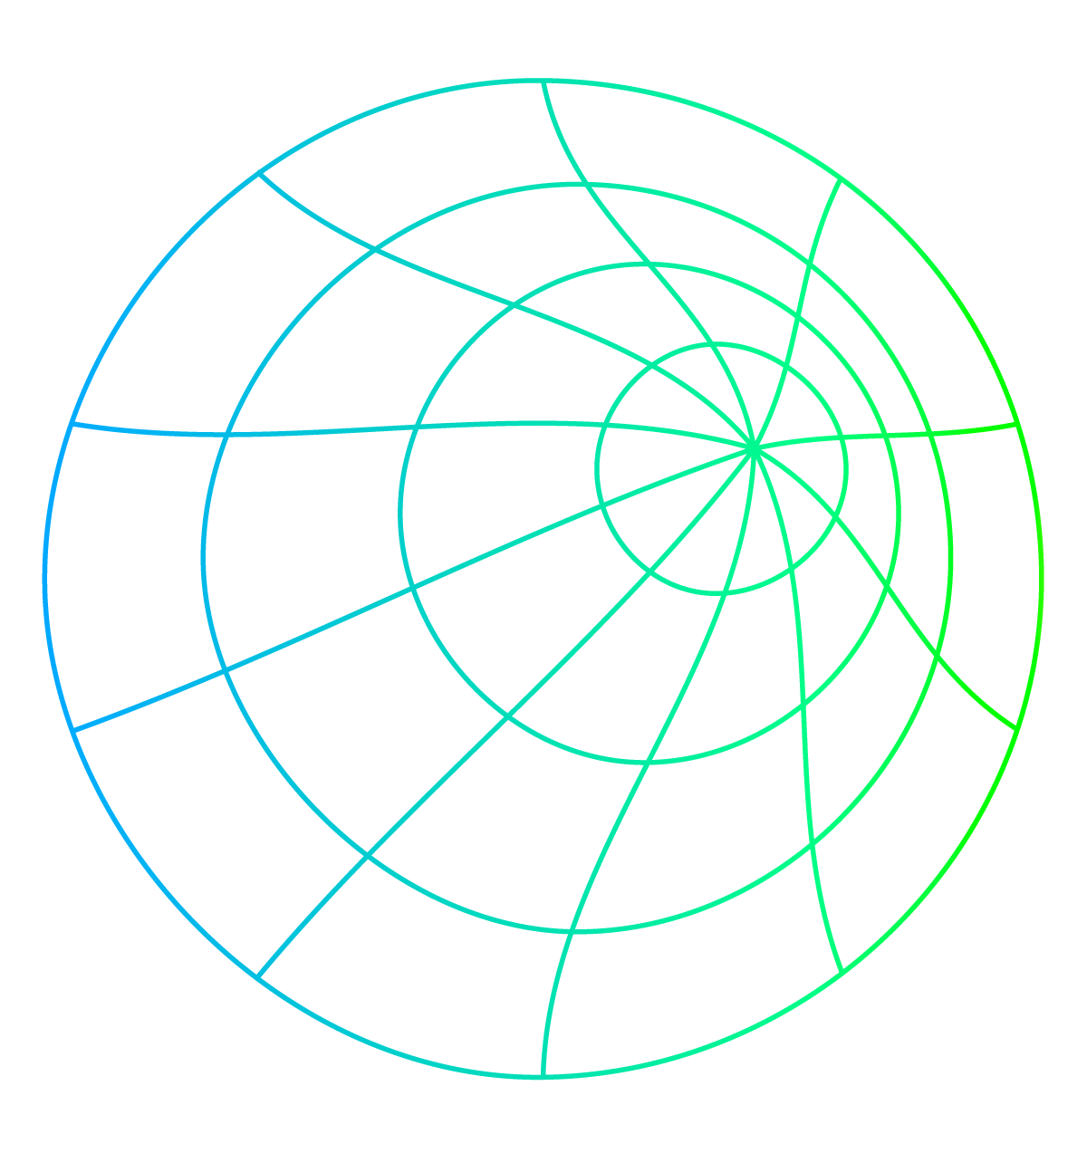
TABLE OF CONTENTS
01
02
03
04
About the project
You can describe the topic of the section here
Major requirements
You can describe the topic of the section here
Project goals
You can describe the topic of the section here
Sneak peek
You can describe the topic of the section here

Slide 5

OUR COMPANY
Jupiter is a gas giant and the biggest planet in the Solar System. It's the fourth-brightest object in the night sky. It was named after the Roman god of the skies and lightning

Slide 6
INTRODUCTION
You can give a brief description of the topic you want to talk about here. For example, if you want to talk about Mercury, you can say that it’s the smallest planet in the entire Solar System

Slide 7
01
About the project
You can enter a subtitle here if you need it

Slide 8
WHAT WE ARE WORKING ON
Project
Mercury is the closest planet to the Sun and the smallest one
Impact
Despite being red, Mars is actually a cold place. It’s full of iron oxide dust
Analysis
Venus has a beautiful name and is the second planet from the Sun

Slide 9
FUNDRAISING CHANNELS
Calls
Portals
Venus is the second planet from the Sun
Jupiter is the biggest planet of them all
Foundations
Fundraising
Despite being red, Mars is a cold place
Saturn is a gas giant and has several rings

Slide 10
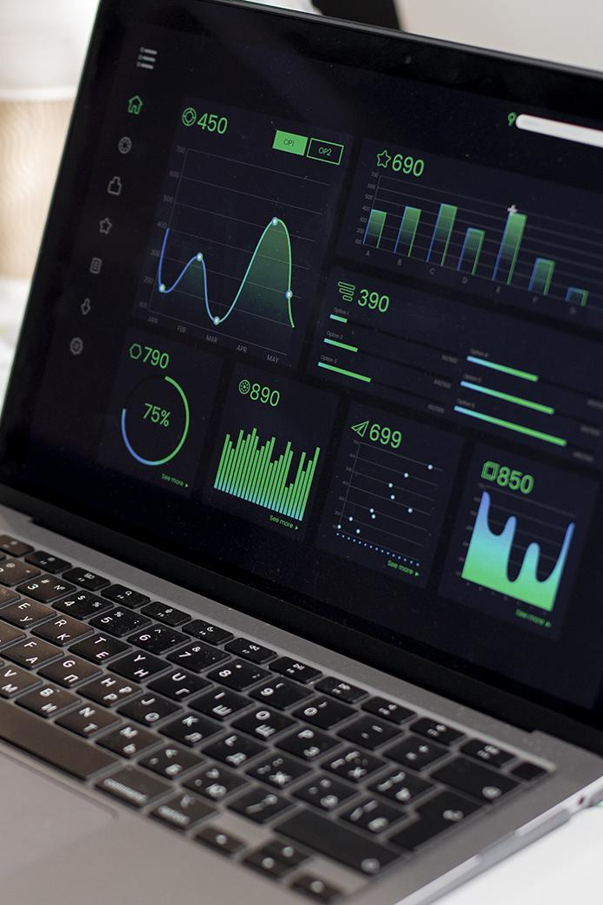
ABOUT THE PROJECT
Mercury is the closest planet to the Sun and the smallest one in the Solar System. This planet's name has nothing to do with the liquid metal, since Mercury was named after the Roman messenger god

Slide 11
DATA PROJECT ARCHITECTURE
Question
Data
EDA
Decision
Modeling
Interpretation
Communication

Slide 12
—Someone Famous
“This is a quote, words full of wisdom that someone important said and can make the reader get inspired.”

Slide 13

NOW
Saturn is a gas giant and has several rings. This planet is composed mostly of hydrogen and helium. Saturn was named after a Roman god

Slide 14
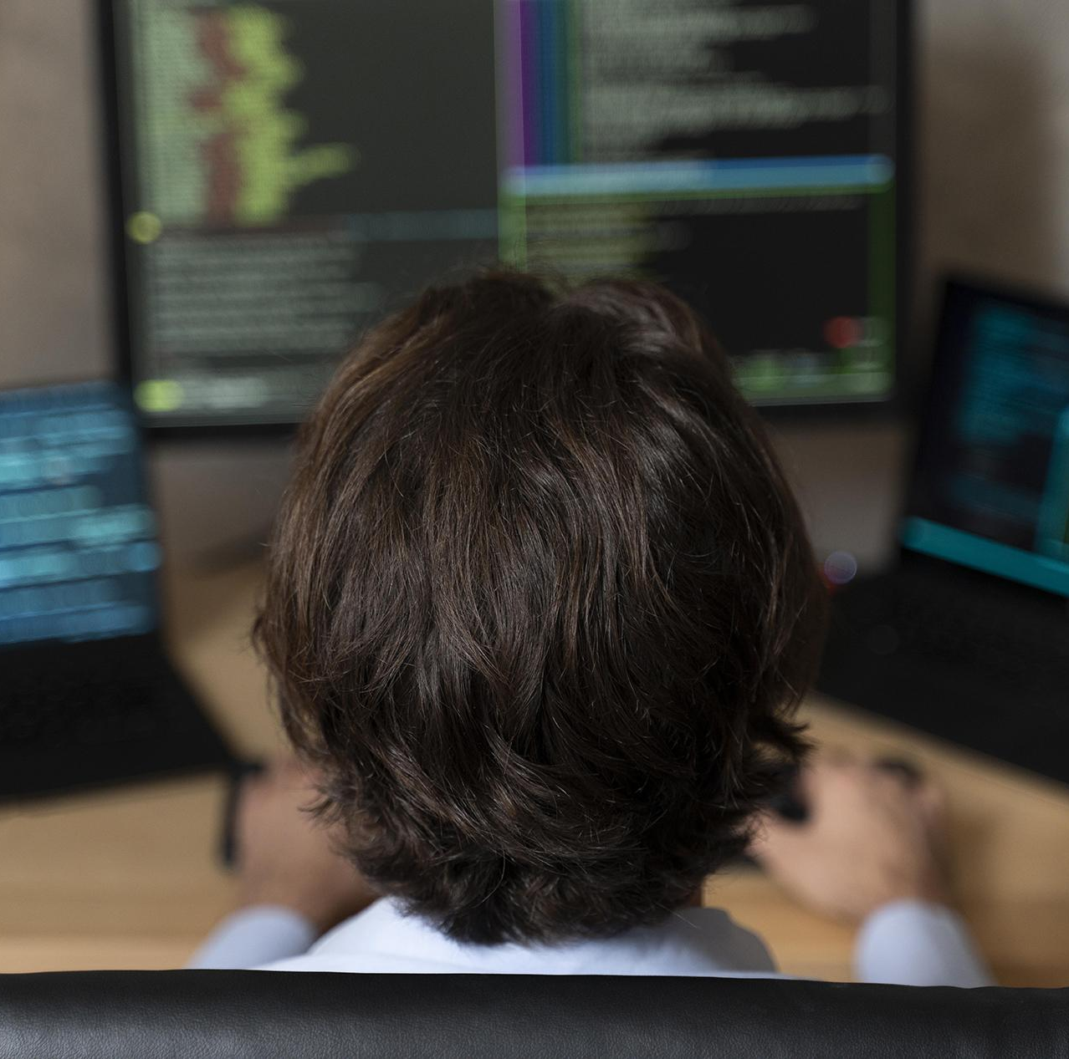
FUTURE
Venus has a beautiful name and is the second planet from the Sun. It’s the second-brightest natural object in the night sky after the Moon

Slide 15
PROJECT PROPOSAL FORM
Saturn is a gas giant with rings. It's composed mostly of hydrogen and helium
Project title | Neptune is far away from us
Impact areas | Saturn is the ringed planet
Context and needs | Jupiter is the biggest planet
Evidence | Mars is a cold place
Short summary | Earth is the third planet from the Sun

Slide 16
SIMILAR PROJECTS
Title | Project A | Project B
Author | James Doe | Anna Smith
Amount | $150,000 | $200,000
TRL level | 5 | 4
Period | Oct 25th - Nov 30th | Dec, 10th - Jan 30th
Key word | Malware | Neural networks
Venus has a beautiful name and is the second planet from the Sun

Slide 17
HOW TO ACHIEVE A FUNDED PROJECT
Mercury is the closest planet to the Sun and the smallest one in the Solar System. Its name has nothing to do with the liquid metal, because Mercury was named after the Roman messenger god
Use bullet points if necessary:
Venus has extremely high temperatures
Earth is the third planet from the Sun
Despite being red, Mars is a cold place
Jupiter is the biggest planet in the Solar System

Slide 18
PROJECT PROPOSAL TEMPLATE
Saturn is a gas giant and has several rings. It's composed mostly of hydrogen and helium. It was named after the Roman god of wealth and agriculture
Problem & solution | What problem have you identified
Methodology | Include a timeline of events here
Goals & KPIs | Describe the details about the project goals

Slide 19
TRANSFORM IDEAS INTO A PROJECT
1st step
Mercury is small
2nd step
Mars is a cold place
Submit
3rd step
Earth harbors life
4th step
Jupiter is quite big

Slide 20
IMPORTANTS SETTINGS
Venus is the second planet from the Sun
Jupiter is the biggest planet of them all
Scope
Constraints
Resources
Risks
Despite being red, Mars is a cold place
Saturn is a gas giant and has several rings

Slide 21
PROJECT GOALS
Goal 1
Goal 2
Mercury is the closest planet to the Sun and the smallest one
Venus has a beautiful name and is the second planet from the Sun

Slide 22
PROJECT GOALS
Goal 1
Goal 2
Goal 3
Goal 4
Saturn is composed mostly of hydrogen and helium
Jupiter is a gas giant and the biggest planet of them all
Despite being red, Mars is actually a cold place
Neptune is the fourth-largest planet in the Solar System

Slide 23
DRAFT OF THE PROJECT PROPOSAL
Jupiter is the biggest planet in the Solar System and the fourth-brightest object in the night sky
Earth is a planet that has life
Neptune is the fourth-largest planet in the Solar System
Despite being red, Mars is actually a very cold place
How a work plan is organized:

Slide 24
02
Major requirements
You can enter a subtitle here if you need it

Slide 25
MAJOR REQUIREMENTS
Mercury
Venus
Mars
It’s the closest planet to the Sun and the smallest one in the Solar System
Venus has a beautiful name and is the second planet from the Sun
Despite being red, Mars is actually a cold place. It’s full of iron oxide dust

Slide 26
SKILLS REQUIRED
Mercury
Venus
Mars
It’s the smallest planet in the Solar System
Venus is the second planet from the Sun
Mars is actually a very cold place
Jupiter
Saturn
Neptune
Jupiter is the biggest planet of them all
It’s composed of hydrogen and helium
It’s the farthest planet from the Sun

Slide 27
MAIN NEEDED QUALIFICATIONS
Mars
Mercury
Venus
Mars is actually a very cold place
It’s the closest planet to the Sun
It’s the second planet from the Sun
Jupiter
Earth
It’s the biggest planet of them all
Earth is the place where we all live

Slide 28
PROJECT ROLES & RESPONSIBILITIES
Roles | Domain expertise | Technical skills | Provable skills
Data scientist
Data engineer
Data science developer
Product owner
Significant expertise
Some expertise
Minimal expertise

Slide 29

AWESOME words

Slide 30

A PICTURE IS WORTH A THOUSAND WORDS

Slide 31

A PICTURE ALWAYS REINFORCES THE CONCEPT
Images reveal large amounts of data, so remember: use an image instead of a long text. Your audience will appreciate it

Slide 32
$1,200,000
Big numbers catch your audience’s attention

Slide 33
$4,250
10
Overall project ROI
Milestones achieved in the last 30 days

Slide 34

BUDGET
Exploitation
40%
Mercury is the closest planet to the Sun
Architecture design
25%
Venus is the second planet from the Sun
Project management
20%
Jupiter is the biggest planet of them all
Dissemination
15%
Neptune is the farthest planet from the Sun
Follow the link in the graph to modify its data and then paste the new one here. For more info, click here

Slide 35

A PICTURE IS WORTH A THOUSAND WORDS

Slide 36
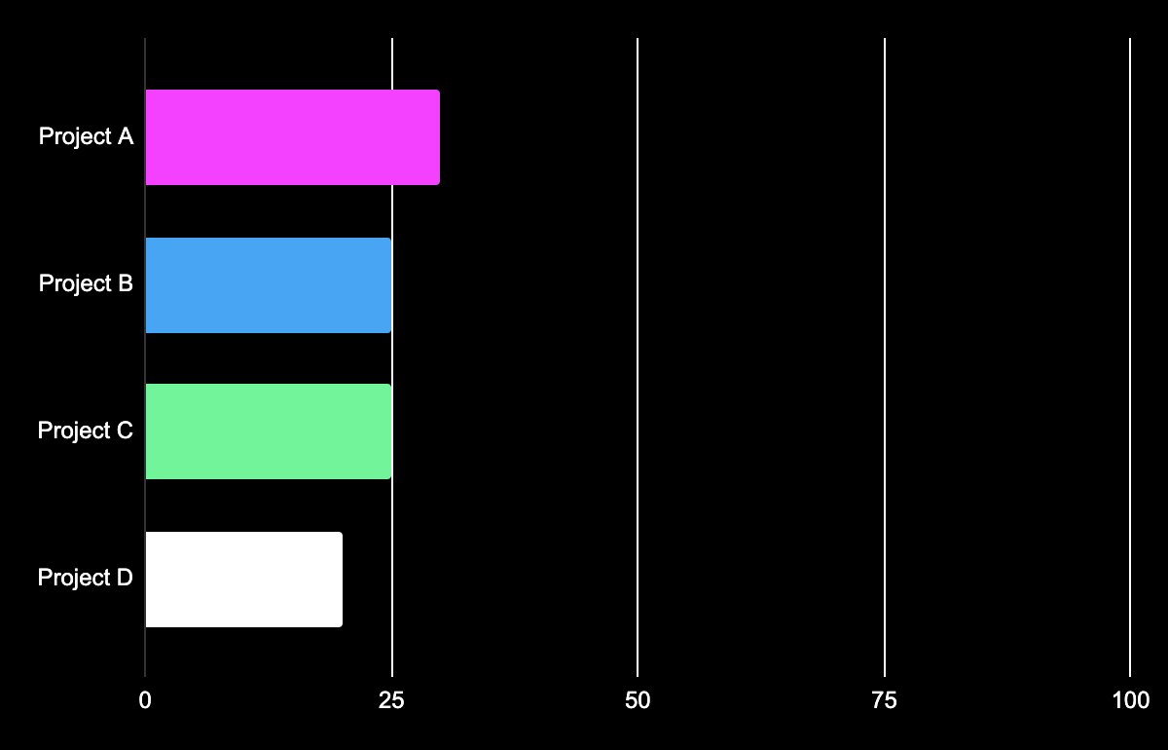
PROJECT PROGRESS
30%
25%
Project A
Project B
Venus is the second planet from the Sun
Despite being red, Mars is a very cold place
25%
20%
Project C
Project D
Earth is the place where we all live
Neptune is the farthest planet from the Sun
Follow the link in the graph to modify its data and then paste the new one here. For more info, click here

Slide 37
PROJECT PROGRESS
Project A
Project B
Progress
75%
Progress
80%
Planned hours
65%
Planned hours
55%
Resources
55%
Resources
50%
Adjustments
60%
Adjustments
75%

Slide 38
WEEKLY REPORT
1st week | 2nd week | 3rd week | 4th week
Mercury is the smallest planet | Venus has a beautiful name | Mars is actually a very cold place | The Moon is a natural satellite
5th week | 6th week | 7th week | 8th week
Jupiter is the biggest planet | Saturn is a gas giant with rings | Pluto is a dwarf planet. It’s small | Earth is the place where we all live

Slide 39
MONTHLY TASKS
M | T | W | T | F | S | S
 | 01 | 02 | 03 | 04 | 05 | 06
07 | 08 | 09 | 10 | 11 | 12 | 13
14 | 15 | 16 | 17 | 18 | 19 | 20
21 | 22 | 23 | 24 | 25 | 26 | 27
28 | 29 | 30 | 31
Task 1
Task 2
Task 3

Slide 40
9h 55m 23s
333,000
386,000 km
Jupiter's rotation period
The Sun’s mass compared to Earth’s
Distance between Earth and the Moon

Slide 41
KEY NUMBERS
1,200
892
63
Planned hours
Hours spent
Adjustments
Despite being red, Mars is actually a cold place. It’s full of iron oxide dust
Venus has a beautiful name and is the second planet from the Sun
Mercury is the closest planet to the Sun and the smallest one

Slide 42
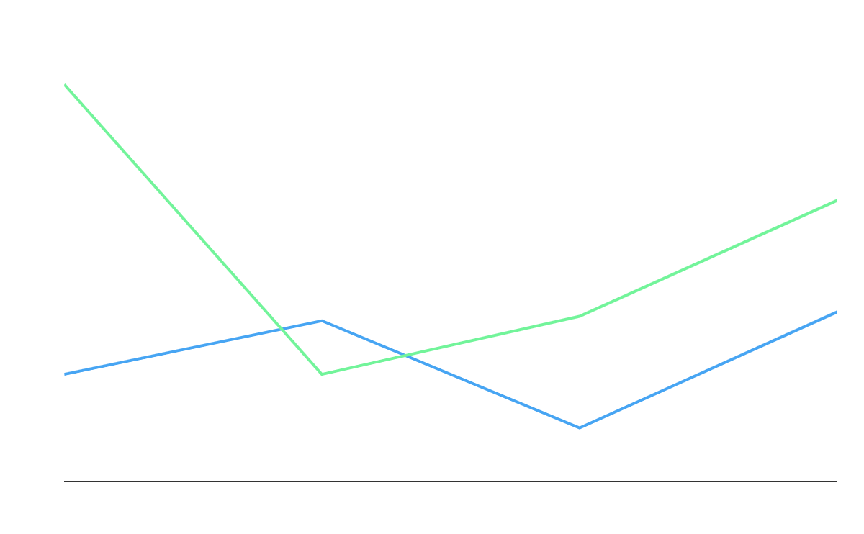
PREDICTED RESULTS
Project A
Saturn is composed of hydrogen and helium
Project B
Jupiter is the biggest planet in the Solar System
Follow the link in the graph to modify its data and then paste the new one here. For more info, click here

Slide 43
GANTT CHART
Finish
Last task
Critical
Not critical
Small task
Initial task
Aug 22
Sep 22
Oct 22
Nov 22
Dec 22

Slide 44
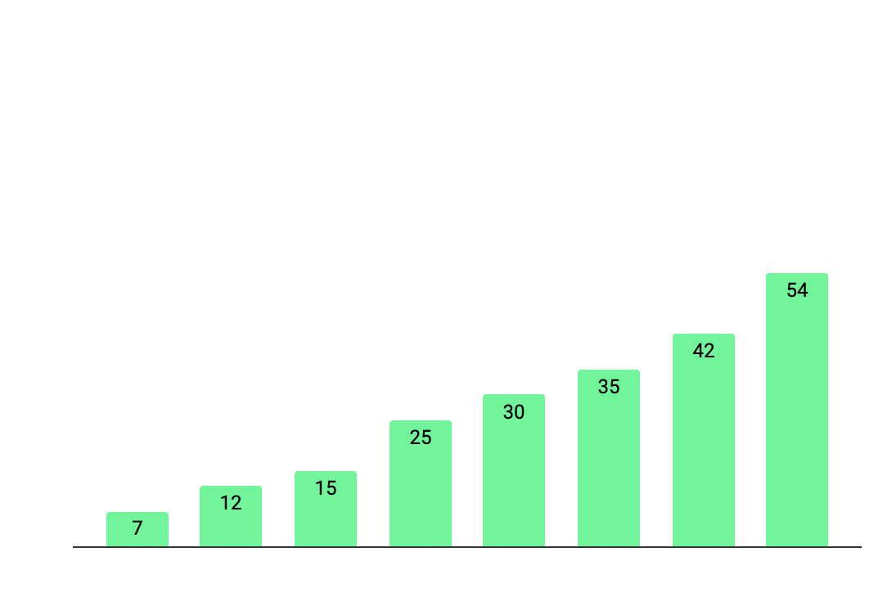
PROJECT SPENT HOURS
190
Original planned time (in hours)
220
Total spent time (in hours)
+15%
Planned hours vs. time spent
Follow the link in the graph to modify its data and then paste the new one here. For more info, click here

Slide 45
PROJECT PLANNING WITH RISKS
Phase | Time | Resources | Risks
Business review | 1 week | All analysts | Economic change
Data interpretation | 2 week | All analysts | Data extraction
Data preparation | 2 week | Data scientists | Data extraction
Modeling | 3 week | Analytics manager | Data problems
Evaluation | 2 week | Data visualizer | Economic change
Deployment | 1 week | Data architect | Data problems

Slide 46
ROAD MAPS
Task | Sep | Oct | Nov | Dec
Data
Analysis
Validation
Wrap up

Slide 47

SNEAK PEEK
Jupiter is a gas giant and the biggest planet in the Solar System. It's the fourth-brightest object in the night sky. It was named after the Roman god of the skies and lightning

Slide 48
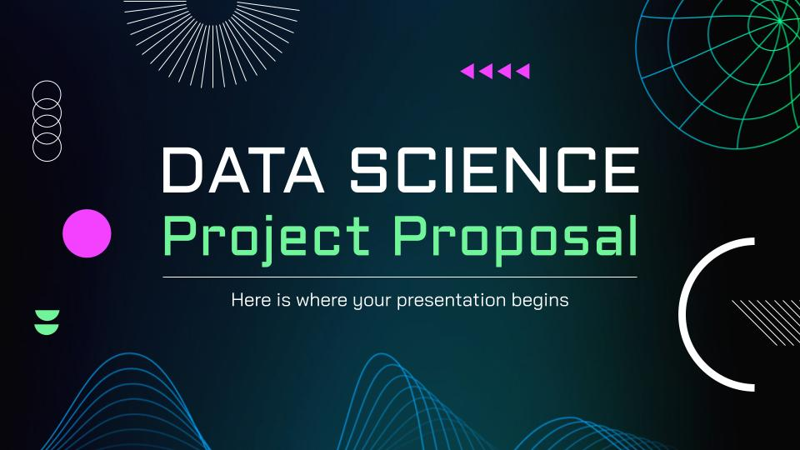
SNEAK PEEK
Insert your multimedia content here

Slide 49
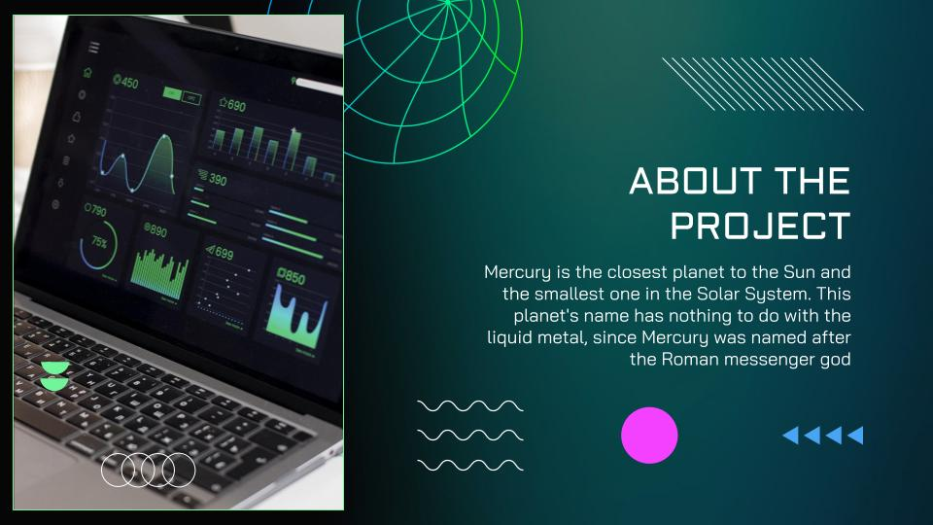
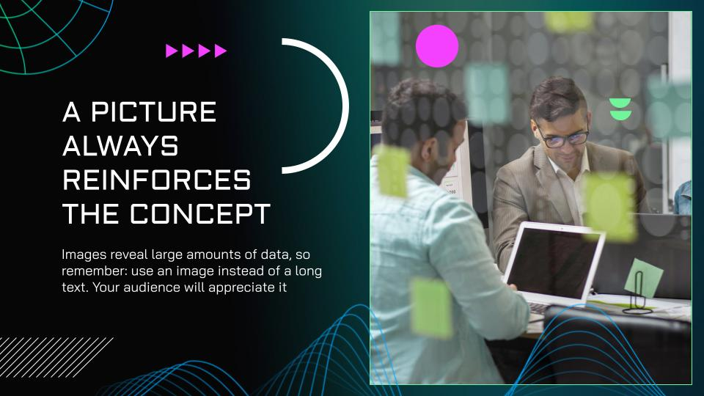
OUR CHANNELS
You can replace the images on the screen with your own work. Just right-click on them and select “Replace image”

Slide 50
PROJECT STAGES
Stage 3
Stage 2
Mercury is the closest planet to the Sun and the smallest one
Stage 1
Despite being red, Mars is actually a cold place. It’s full of iron oxide dust
Venus has a beautiful name and is the second planet from the Sun

Slide 51
TIMELINE
Venus
Mars
Venus is the second planet from the Sun
Mars is actually a very cold place
Jupiter
Saturn
Neptune
Jupiter is the biggest planet of them all
It’s composed of hydrogen and helium
It’s the farthest planet from the Sun

Slide 52
OUR PARTNERS
Saturn
Jupiter
Saturn was named after the Roman god of wealth and agriculture
Jupiter is a gas giant and the biggest planet in the Solar System
Earth
Mars
Earth is the only planet that harbors life in the Solar System
Despite being red, Mars is actually a cold place. It's full of iron oxide dust

Slide 53
SEARCH FOR PARTNERS
Mercury
It’s the closest planet to the Sun
Venus
Venus is the second planet from the Sun
Jupiter
Jupiter is the biggest planet of them all
Mars
Mars is actually a very cold place
Saturn
It’s composed of hydrogen and helium

Slide 54



OUR TEAM
Anna Smith
John Doe
Linda Adams
You can speak a bit about this person here
You can speak a bit about this person here
You can speak a bit about this person here

Slide 55




OUR TEAM
John Doe
James Jimmy
You can speak a bit about this person here
You can speak a bit about this person here
Bob Smith
Jenna Adams
You can speak a bit about this person here
You can speak a bit about this person here

Slide 56
LOCATIONS
Jupiter
It’s the biggest planet in the Solar System
Saturn
Saturn is a gas giant and has several rings
Mars
Despite being red, Mars is a cold place

Slide 57
PROGRESS TABLE
 | Test A | Test B | Test C
Project 1
Project 2
Project 3

Slide 58
PROJECT MANAGEMENT
ID | Tasks | Week 1 | Week 2 | Week 3 | Week 4
1 | Start
2 | Clean the data
3 | Analyze data
4 | Customer approval
5 | Sign off

Slide 59
FINAL REMINDERS
Subject
Area
You can describe the most important points here | Area 1
You can describe the most important points here | Area 2
You can describe the most important points here | Area 3
You can describe the most important points here | Area 4
You can describe the most important points here | Area 5

Slide 60

THANKS
Do you have any questions?
youremail@freepik.com
+91 620 421 838
yourwebsite.com
Please keep this slide for attribution

Slide 61
ICON PACK

Slide 62
ALTERNATIVE INFOGRAPHICS
Despite being red, Mars is cold
Step 1
Step 2
Mars
Neptune is the farthest planet from the Sun
01
02
Despite being red, Mars is a cold place
Neptune
Neptune is far away from us
It has a beautiful name but is hot
Venus
Step 3
Step 4
Saturn is a gas giant with rings
Venus has a beautiful name, but it’s hot
03
04
Pluto is now considered a dwarf planet
Saturn
Sep
Nov
Mars
Despite being red, Mars is a cold place
Despite being red, Mars is a cold place
Venus has a beautiful name, but it’s hot
Neptune is far away from Earth
Neptune
Aug
Oct
Saturn
Saturn is a gas giant and has several rings
Saturn is a gas giant with several rings
Neptune is the farthest planet from the Sun
It has a beautiful name, but it’s hot
Venus

Slide 63


ALTERNATIVE RESOURCES
Here’s an assortment of alternative resources whose style fits the one of this template:
Flat abstract wireframe background

Slide 64
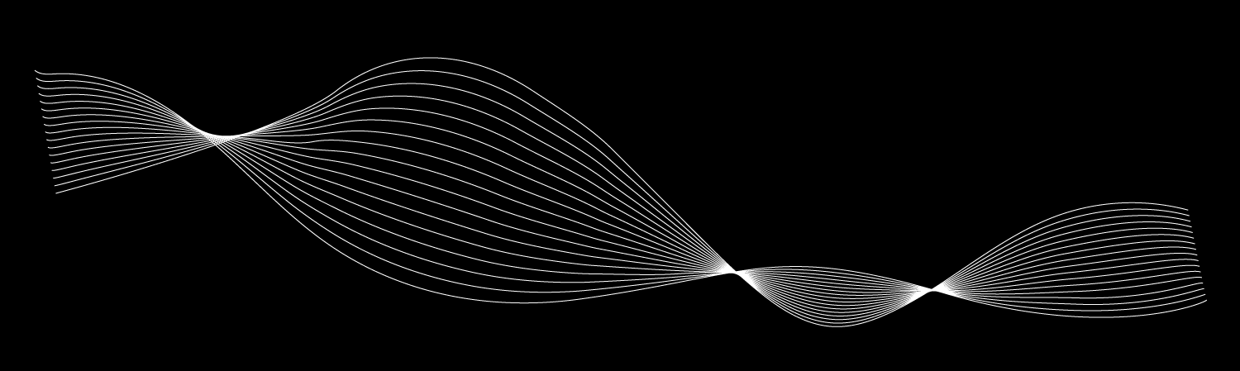


ALTERNATIVE RESOURCES
Here’s an assortment of alternative resources whose style fits the one of this template:
Flat abstract wireframe background I

Slide 65
RESOURCES
Did you like the resources on this template? Get them for free at our other websites:
Photos
Modern and equipped computer lab I
Modern and equipped computer lab II
Modern and equipped computer lab III
Modern and equipped computer lab IV
Modern and equipped computer lab V
Modern and equipped computer lab VI
Close up programmer sitting at desk I
Close up programmer sitting at desk II
Medium shot man sitting at desk
Medium shot man typing on laptop
Close up on film texture details
Vectors
Gradient abstract wireframe background

Slide 66
PREMIUM RESOURCES
Did you like the resources on this template? Get them for free at our other websites:
Photos
Front view group of smiley friends
Smiley people attending a group session
Portrait of young woman with her crossed arms against background
Close up shot smiling aged man
Modern and equipped computer lab
Icons
Icon Pack: Project Planning | Lineal

Slide 67
Instructions for use
In order to use this template, you must credit Slidesgo by keeping the Thanks slide.
You are allowed to:
- Modify this template.
- Use it for both personal and commercial projects.
You are not allowed to:
- Sublicense, sell or rent any of Slidesgo Content (or a modified version of Slidesgo Content).
- Distribute Slidesgo Content unless it has been expressly authorized by Slidesgo.
- Include Slidesgo Content in an online or offline database or file.
- Offer Slidesgo templates (or modified versions of Slidesgo templates) for download.
- Acquire the copyright of Slidesgo Content.
For more information about editing slides, please read our FAQs or visit Slidesgo School:
https://slidesgo.com/faqs and https://slidesgo.com/slidesgo-school

Slide 68
Instructions for use (premium users)
As a Premium user, you can use this template without attributing Slidesgo or keeping the "Thanks" slide.
You are allowed to:
Modify this template.
Use it for both personal and commercial purposes.
Hide or delete the “Thanks” slide and the mention to Slidesgo in the credits.
Share this template in an editable format with people who are not part of your team.
You are not allowed to:
Sublicense, sell or rent this Slidesgo Template (or a modified version of this Slidesgo Template).
Distribute this Slidesgo Template (or a modified version of this Slidesgo Template) or include it in a database or in any other product or service that offers downloadable images, icons or presentations that may be subject to distribution or resale.
Use any of the elements that are part of this Slidesgo Template in an isolated and separated way from this Template.
Register any of the elements that are part of this template as a trademark or logo, or register it as a work in an intellectual property registry or similar.
For more information about editing slides, please read our FAQs or visit Slidesgo School:
https://slidesgo.com/faqs and https://slidesgo.com/slidesgo-school

